Slide 1
A presentation about HECC-IT and Backblast
A presentation/demonstration by Rachel Lowe
(and I guess promptly followed by some sort of oral interview)
https://cseegit.essex.ac.uk/ce301_2020/ce301_lowe_richard_m
https://cseejira.essex.ac.uk/projects/A301034

Slide 2
Agenda
What is a hypertext game?
HECC-IT
Context
Using it
Developing HECC-IT
Conclusions
Backblast
Production
Conclusions
Some Jira reports
Demonstration
Q&A

Slide 3
What is a hypertext game?
Hypertext
‘a body of written or pictorial material interconnected in such a complex way that it could not conveniently be presented or represented on paper’[1]
Non-linear, very much interconnected structure.
Hypertext game
‘a subset of games, with a constrained set of mechanics based around textual lexia and link following’[2]
Player reads text
Player is given options in the form of links
Player chooses which option to take/which link to follow
Player presented with the consequences of their choice
Notes:
[1] T. H. Nelson, "Complex information processing: a file structure for the complex, the changing and the indeterminate," in ACM '65: Proceedings of the 1965 20th national conference, New York, NY, 1965.
[2] D. E. Millard, "Games/Hypertext," in Proceedings of the 31st ACM Conference on Hypertext and Social Media, Virtual Event, 2020.

Slide 4
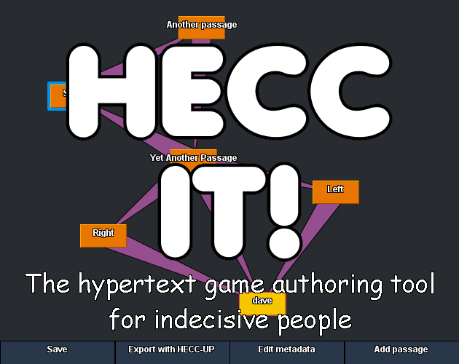
HECC-IT
Hypertext Editing and Creation Code Integrated Toolkit
https://11belowstudio.itch.io/hecc-it

Slide 5
The context for HECC-IT
Existing hypertext game authoring tools
HECC-IT
Most have options to export games playable via browser
Most are freeware
Produced games can incorporate conditional logic
Most consist entirely of a scripting language or a GUI
Some have both, but one must convert the format of the WIP game file to swap between editing methods
Produces games playable via browser
Is freeware
Produced games can incorporate conditional logic
Authors may edit games using a scripting language and a GUI
Uses the same intermediate format for both editing methods, the only ‘conversion’ is for exporting games.
Notes:
Explaining current state of the art

Slide 6
Using HECC-IT
Authors create a .hecc file
A scripting language, defined in the HECC-SPECC, for WIP games
Authors declare the content of the game within the .hecc file
May do this manually
May do this via OH-HECC
Authors export the .hecc file into a playable, html-format game, via HECC-UP
Large-scale editing in OH-HECC
Smaller-scale editing directly in the .hecc file
Export the .hecc file with HECC-UP

Slide 7
Making HECC-IT
Summer/Challenge Week 2020
First version of the HECCIN’ Game HTML/JavaScript game engine
First version of the HECC-UP export utility
Autumn Term
First version of OH-HECC
Spring Term
Enhancements to the HECCIN’ Game
Enhancements to OH-HECC and HECC-UP
Writing Backblast
Combining OH-HECC and HECC-UP into one utility

Slide 8
Creating the HECCIN’ Game
Key challenges
How they were overcome
Designing the HECCIN’ Game
Learning JavaScript to implement this design
Incorporating markdown formatting into the passage contents
Implementing conditional logic into the games
State machine-style architecture.
‘Passage’ objects stored in a map, indexed by name. Stack of visited ‘gamestates’ for a ‘back’ button
Learned JavaScript
Used the ‘showdown.js’ markdown implementation
Conditional statements, based on the game-state history stack
Whether or not/count of times the passage/tag(s) were encountered
Currently implemented via eval (ab)use.
Notes:
Proper variables were considered, did not get around to implementing them
Conditional logic: it works. I am planning to work out how to remove the eval abuse, but that’ll be a job for after I’m done with exams and moving the codebase to my personal github
Stretch goals: variables. Saving/loading games whilst playing them.

Slide 9
Creating HECC-UP
Key challenges
How they were overcome
Defining the .hecc language, which this would need to read.
Reading the .hecc file into a proper data structure
Outputting the game defined in the .hecc file as something playable
Letting a user select the files
Created it, inspired by the syntaxes of twee2 and squiffy
Loops through .hecc code, finds ‘tokens’ via regexes, constructs a directed graph of passages
Most components prewritten, only ‘makes’ the game data file.
Used JFileChoosers in the GUI.
Notes:
The directed graph: in the form of a Map<String, Passage> (key is passage name), with each passage having a Set<String> (names of the passages it links to)

Slide 10
Creating OH-HECC
Key challenges
How they were overcome
Designing the OH-HECC editor
Redesigning the OH-HECC editor due to a redundant update loop
Maintaining structure and consistency of game when editing individual components
Opening .hecc files
Input validation
Letting author ‘drag’ passages and the viewable area
Saving .hecc files
Used an MVC architecture
Simplified it significantly, only needing to use event handling
Internally referencing each passage via constant UUIDs, not by (changeable) names
Reused (less strict) parsing logic
Some reused & new regexes
Find difference in mouse position between each event as vector, apply that vector to the scroll offset/position of that passage
‘toHecc’ methods to produce .hecc code

Slide 11
Conclusions regarding HECC-IT
Successes
Stretch Goals
It can produce hypertext games
Games are playable via browser
Author is free to edit their WIP games however they want
Conditional logic may be used
OH-HECC assists in producing valid .hecc code
HECC-UP explains problems with an invalid .hecc file
Implementing variables into the game’s conditional logic
Refactoring out the eval abuse
Migrate HECC-IT codebase to a more recent version of Java
Would need to export a separate executable for each OS though
Custom CSS options
More options for the game’s runtime behaviour

Slide 12
Backblast
A murder mystery where you are the victim!
https://11belowstudio.itch.io/backblast

Slide 13
What is Backblast?
A hypertext game, produced with HECC-IT
Demonstrating that HECC-IT is usable to produce hypertext games
Showing that HECC-IT can be used to produce larger games as well
Overall structure mostly reminiscent of a ‘branching novel’
Second-person narrative, addressing player directly
Most links are at the end of each passage
However, the structure is intentionally somewhat cyclical
‘Game’ elements
Several choices made along the way will affect which endings are available
Player is never explicitly informed about which choices are/are not meaningful
Player is trying to work out who is killing them, and why

Slide 14
Initial ideas
During research, found out that ‘the cycle, … is the central hypertext structure’[3]
Considered making a game with an overall cyclical structure
‘Stuck in a time loop’ trope seemed appropriate
Ideas of parallel universes and a time bomb felt like a good fit for that
Initially considered having a cast of potential suspects, player would have to eliminate each suspect one by one (dying multiple times) to find the culprit
End result was somewhat different
Invited to a secret pseudoscience-y research lab as a test subject.
Chaos ensues.
Notes:
[3] M. Bernstein, "On hypertext narrative," in HT '09: Proceedings of the 20th ACM conference on Hypertext and hypermedia, Torino, 2009.

Slide 15
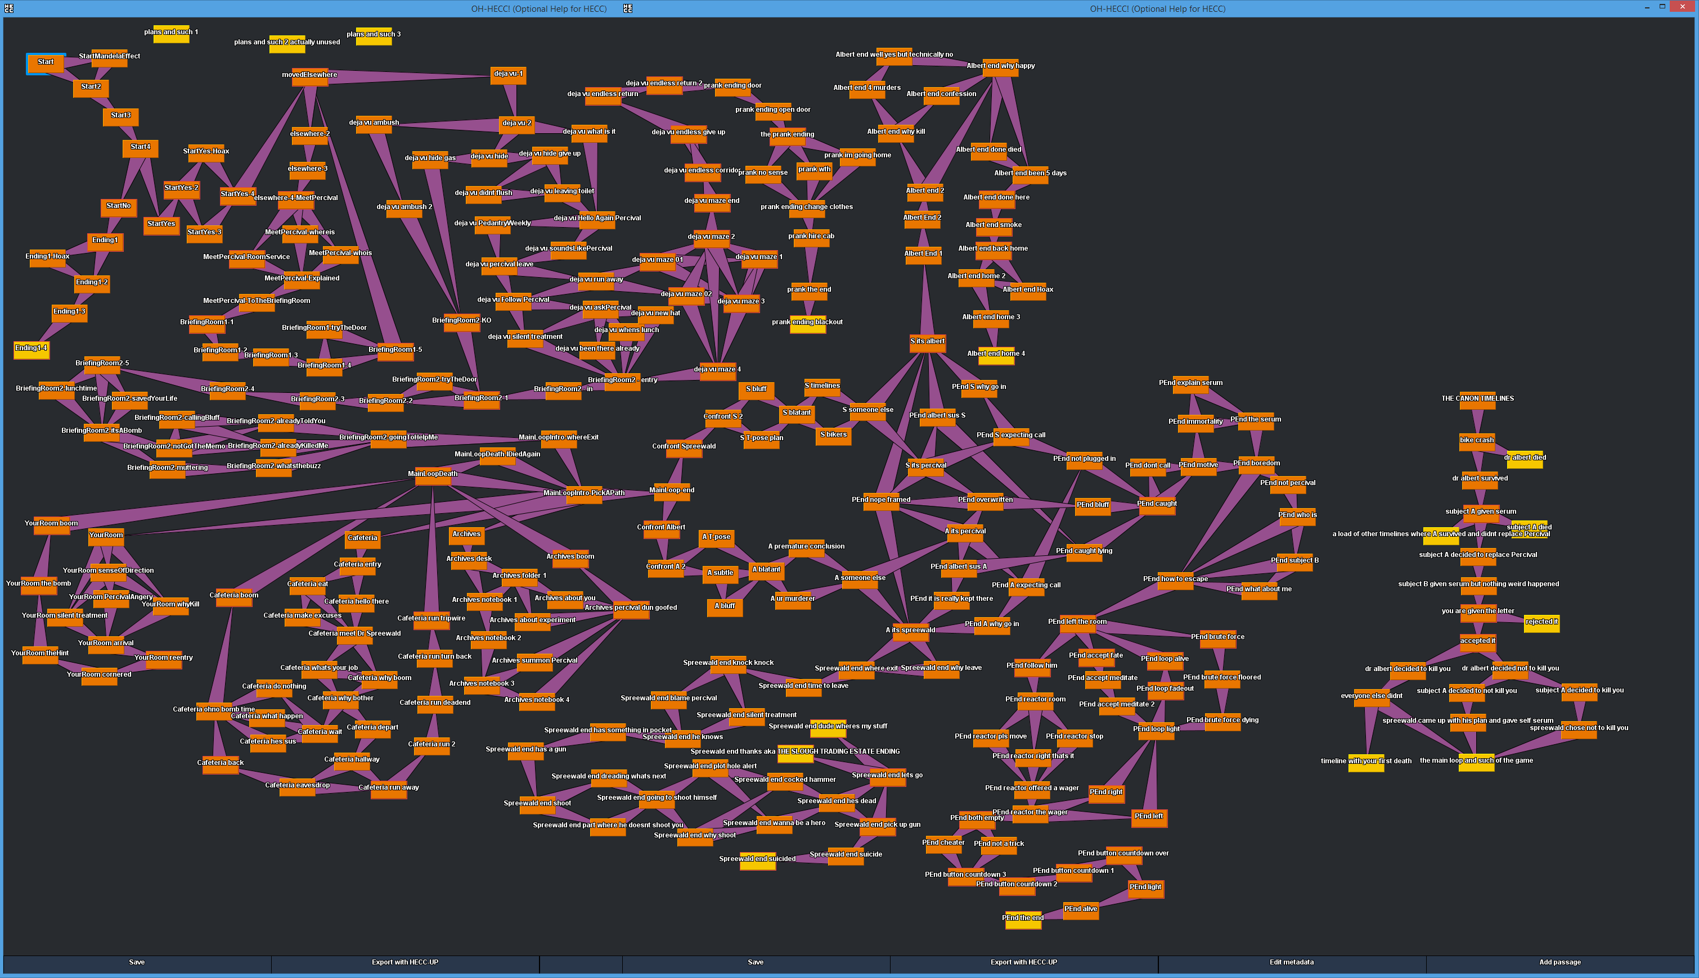
Overall structure of the game
Notes:
Letter about a mysterious opportunity from some ‘Dr Albert’ person, given an option to accept it or reject it
reject: that’s an ending
accept: continues to the rest of the game (kidnapped)
Eventually goes to the first ‘death’
Wake up in an unfamiliar room
Introduced to Percival
You die
Revisiting that first ‘death’
Can eventually opt to run away, find a ‘secret ending’ where it’s just a prank bro
Otherwise go back to the place where you first died, and then avoid dying this time
Ask Percival what’s going on
Main ‘loop’
You die 3 more times
Meet Dr Spreewald
Could potentially find out some useful information
The start of the endings
Option of accusing Spreewald is always there
Option of accusing Dr Albert not always there (only there if you made some certain choices)
First accusation always wrong (ngl this is where the ‘mystery’ aspect falls apart)
Eventually have to accuse the other person
Depending on choices from earlier, may have the option of accusing Percival
Will need to actually remember the suspicious thing Percival did

Slide 16
Conclusions about Backblast
The good parts
The bad parts
It’s a playable hypertext game
Roughly 15-30 minutes of content
Some replayability from the multiple endings/branches
Introduction sequence (up to the first death) sets up a somewhat engaging central mystery
Causal links between passages
Conditional logic ‘remembers’ earlier choices, changes some passage content/available options later on.
No ‘infinite loops’
Overall structure is very linear
Poorly designed overall
Especially in the middle section
The ‘murder mystery’ aspect is sabotaged by the endings
The ‘Subject A’ ending was a retcon
Didn’t take a proper look at the current state of the market
Doesn’t really attempt making an artistic statement
Some player frustration from the ‘point of no return’ passages
Notes:
THE GOOD
It’s a hypertext game!
THE BAD
Linear design: not very ‘hypertextual’
Poor design:
The intro had some design behind it
The end had some design behind that
But the middle was basically played by ear, and the start/end aren’t really consistent with each other
Endings
Yeah the player’s initial accusation is wrong all the time; what’s the point of a murder mystery if the player’s one chance of ‘solving’ it is made redundant
Lack of a statement
There was one other game I did attempt making, called ‘Assigned’. Basically the point about that one was frustration about assigned genders etc.
Put on hiatus/cancelled because it felt too much like bashing the player’s skull in with the intended message
I have been in a kinda shit state mentally over the past few months though, and I guess that the depressing nature of the Spreewald and Subject A endings were a consequence of that.
‘point of no return’ passages
Wanted to make the player feel more ‘stuck’ in certain points (cornered/unable to escape/made a very regrettable choice with consequences that cannot be escaped)
But the intention probably didn’t make itself felt correctly.

Slide 17
Some graphs with my activity on Jira
A brief overview of project planning

Slide 18
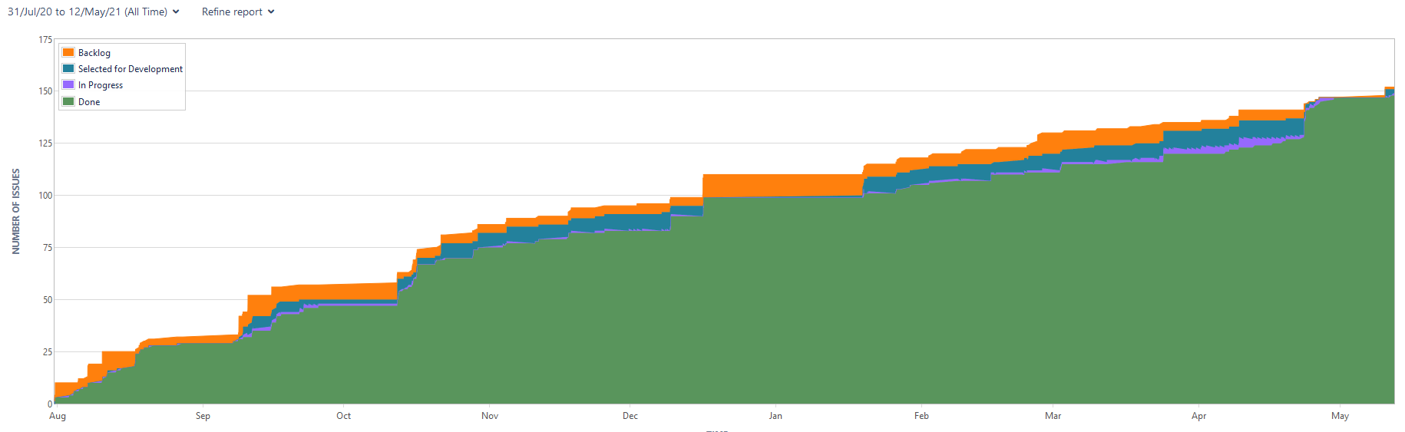
Cumulative flow diagram for all issues recorded on Jira

Slide 19
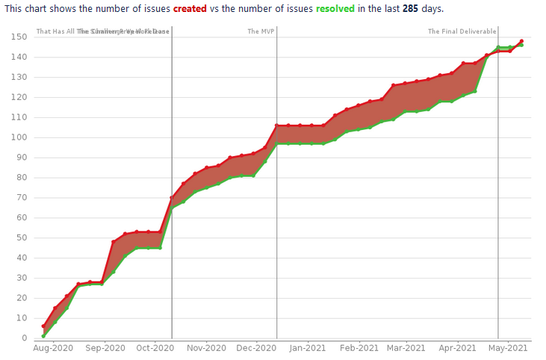
Created vs resolved issues

Slide 20
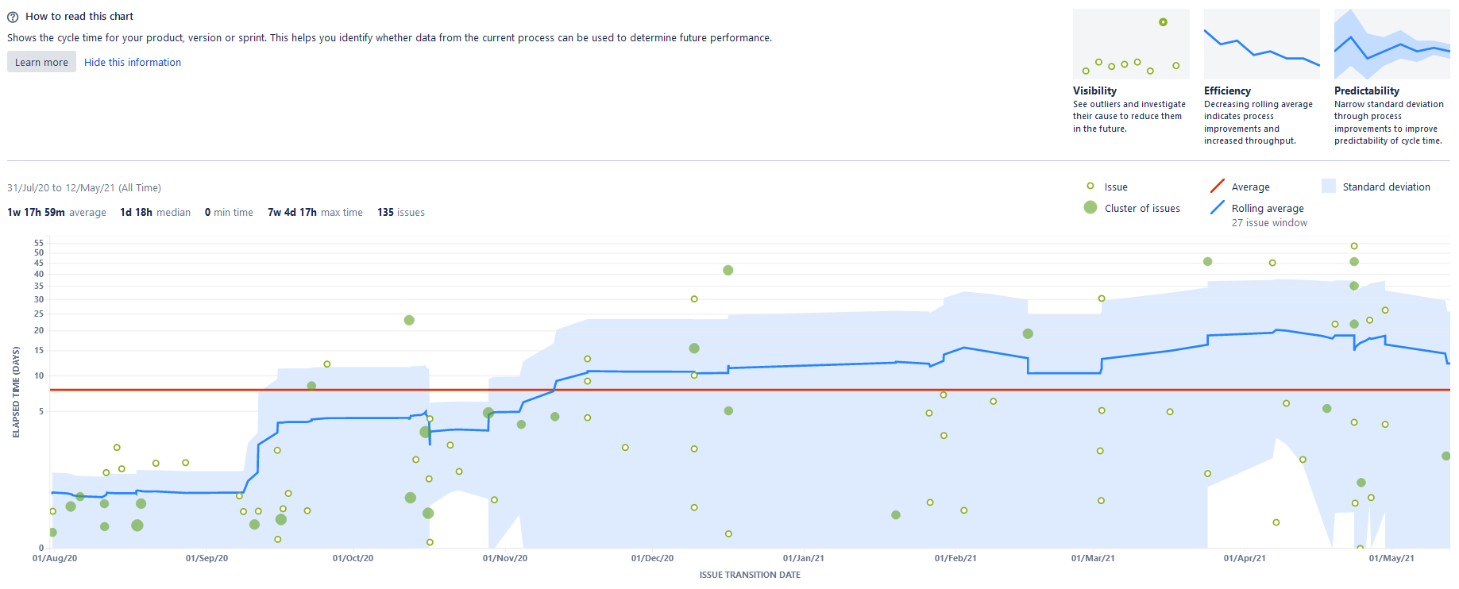
Control chart for all issues so far

Slide 21
Summary of the time tracking reports
(13 * 40) + (9 * 8) + 6 = 520 + 72 + 6 = 602 hours logged on Jira

Slide 22
The Demonstration
Using HECC-IT to make and then play some hypertext games
Notes:
I’ll show you how to use OH-HECC to create a .hecc file, add some content to the .hecc file, save it, and show you the saved .hecc file.
Then I’ll open another .hecc file, show you how to open it for editing, make a few changes to it, and then use HECC-UP to edit it and open it in browser.
I’ll also show you how that game works.
And, to end it, I shall show what happens if you attempt giving an invalid .hecc file to HECC-UP, and then show you what happens if you edit a valid .hecc file to make it invalid in OH-HECC.

Slide 23
The Q&A
Ask away!
Notes:
This is the allocated time for questions

Slide 24
Summer 2020/Challenge Week
Challenges
Successes
Designing the HECCIN’ Game engine
Learning JavaScript for the HECCIN’ Game engine
Designing the .hecc language
Creating a parser for .hecc
Making a parsing utility program
Creating an example game
I went with a state machine design, also storing ‘previous’ states on a stack.
I was able to learn and use it.
Created the HECC-SPECC
Created a prototype of HECC-UP
Refined it further, it had a GUI
Produced ‘A Conversation’

Slide 25
Winter 2020
Challenges
Successes
Designing the OH-HECC editor
Redesigning OH-HECC to remove a redundant passive update loop
Ensuring that all edits
Used an MVC architecture
Completely refactored that out, simply using event handling.

Slide 26
Bibliography
[1] T. H. Nelson, "Complex information processing: a file structure for the complex, the changing and the indeterminate," in ACM '65: Proceedings of the 1965 20th national conference, New York, NY, 1965.
[2] D. E. Millard, "Games/Hypertext," in Proceedings of the 31st ACM Conference on Hypertext and Social Media, Virtual Event, 2020
[3] M. Bernstein, "On hypertext narrative," in HT '09: Proceedings of the 20th ACM conference on Hypertext and hypermedia, Torino, 2009.

